Slide 1

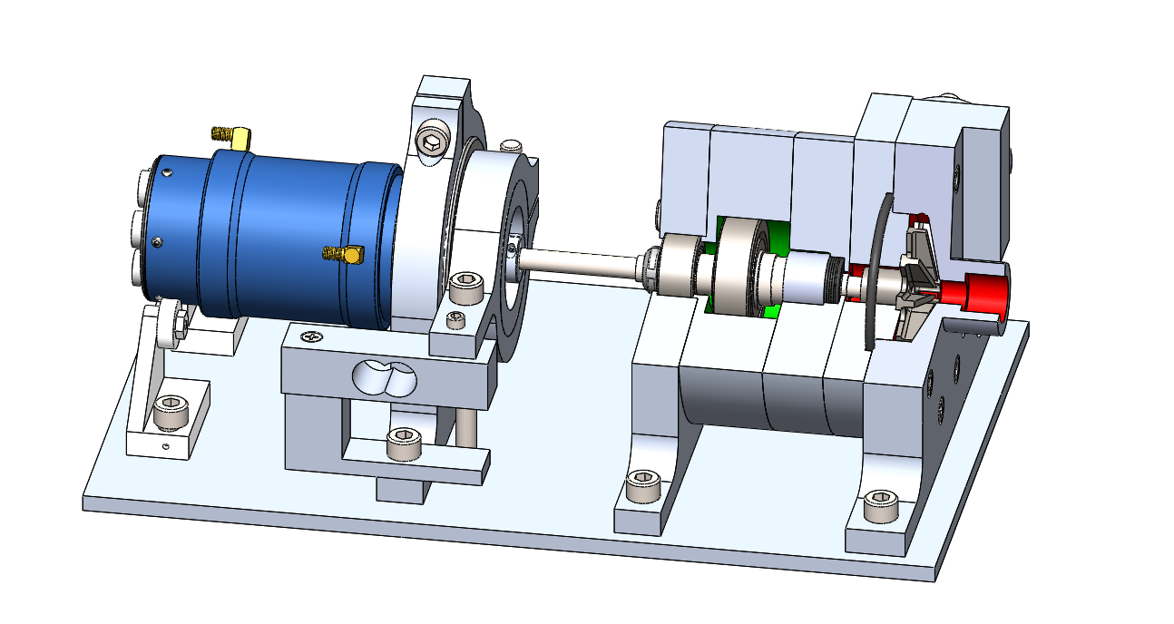
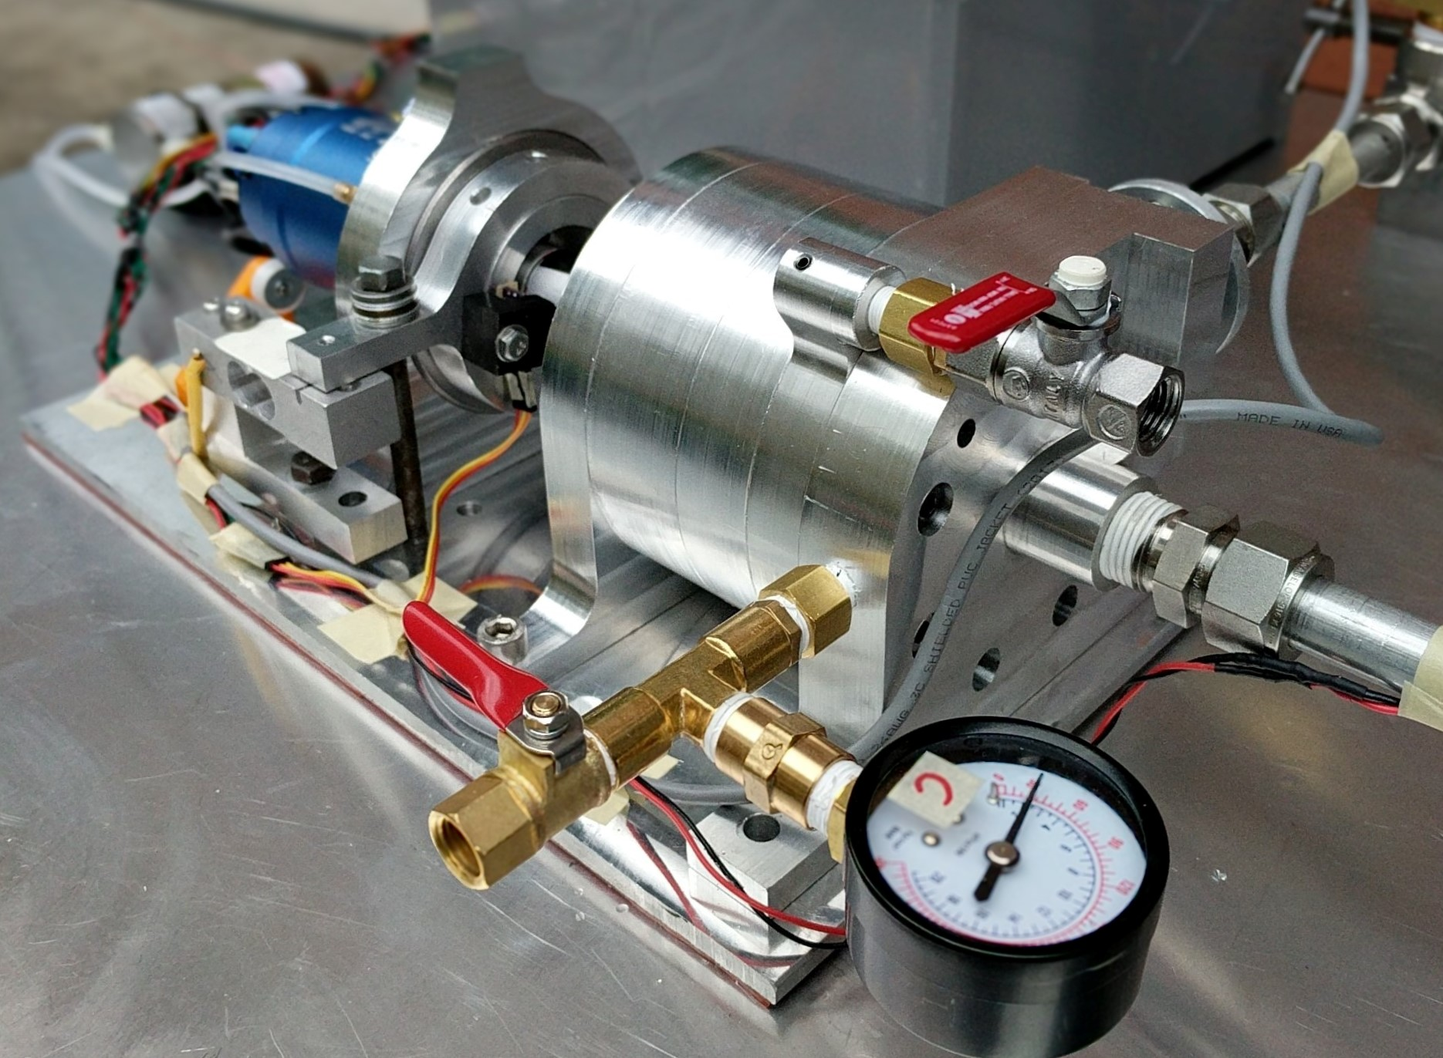
Electric Propellant Feed System (EFS)
Team Members: John C. Froehlich, Jonathan Talik, James Luce, Rawand Rasheed, Mimi Shang and Jordan Roland
Sponsor: Portland State Aerospace Society
Project Objective Statement
The goal of the EFS project is to design, build, and test an electric propellant feed system for the PSAS LV4 liquid fueled bi-propellant rocket engine prototype by June 6, 2017.
The Design
Measured Performance
Show concrete, quantitative evidence that your device works. Show how, and to what degree, your design meets the key customer requirements. Plots, photos of the device in action, or tables of results would be good to add. However, do not cram too much information into the space
This is where you show your convincing evidence for the success of your project
Motivation
Historically, the technology used to deliver liquid propellant into a rocket’s combustion chamber has been to use complex turbopumps or heavy pressurized gas tanks, making these difficult solutions for amateur rocketry. Recent advances in battery technology may allow an electric motor powered rocket propellant pump to compete with the effectiveness of a turbopump while weighing less than a pressure fed system.
The open source development of an electric motor powered, high speed centrifugal pump feed system is a step forward towards making low cost bipropellant rockets capable of reaching low Earth orbit accessible to amateurs and academic rocketry groups.
Plot or table of final performance results
Assembly model
Casing/diffuser design
Impeller
Rotating elements
Figure caption and maybe a short paragraph of explanatory text
Concept 1
Concept 2
Lessons Learned / Future Work
- The
Key Customer Requirements
Design, build and test a technology development platform for the electronic propellant feed system.
Design a pump capable of delivering 350 psi of pressure to the combustion chamber of the LV4 rocket.
Design a pump capable of delivering roughly 11 gpm of liquid to the engine.
Pump performance characterization.
Scalable proof of concept design for future iterations.
Open source documentation, design artifacts and build information.
Photo of subsystem or device in action. ACTION SPRAY SHOT FROM TEST BENCH
Figure caption and maybe a short paragraph of explanatory text
Prototype assembled for testing
Literature Cited & Credits
This poster template is derived from a template created by Colin Purrington, which can be found at http://colinpurrington.com/tips/academic/ posterdesign.
B.R. Munson et al., Fundamentals of Fluid Mechanics, 7th ed., 2012, Wiley.
Acknowledgments
Mike Chung
Kris Auclair
Haneef Mubarak
Andrew Greenberg
Thank you to our sponsors
ACME Corporation
URS Electronics
Mechanical Materials Engineering Department
Project Website
https://github.com/psas/electric-feed-system

